Slide 1
Standard Query Language SQL
Lecture 3

Slide 2
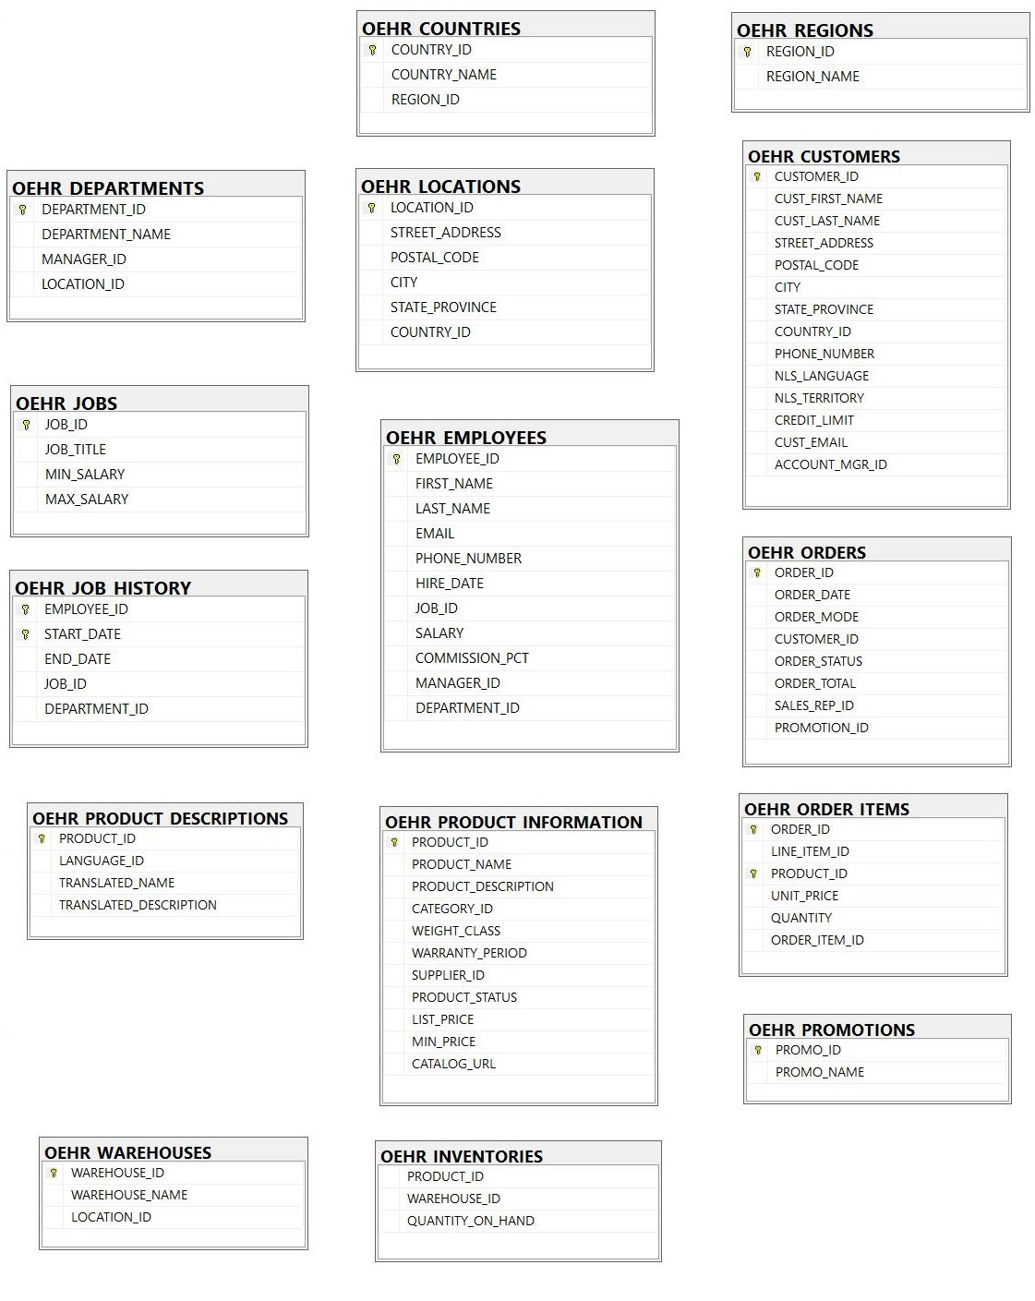

Slide 5
ERD Diagram
A customer complains about an employee, how to find the data of the employee?
Why not Country Name as PK and why Country ID?

Slide 6
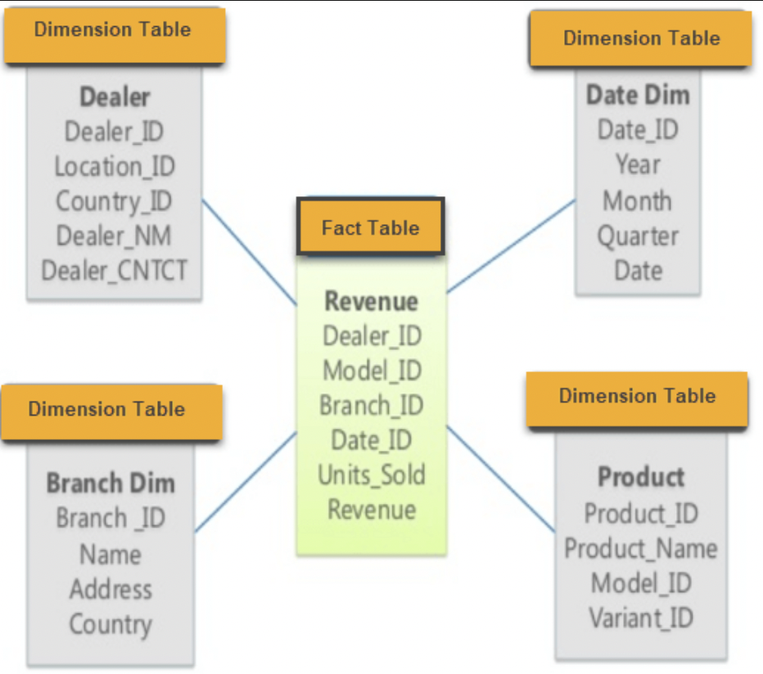
Star Schema

Slide 7
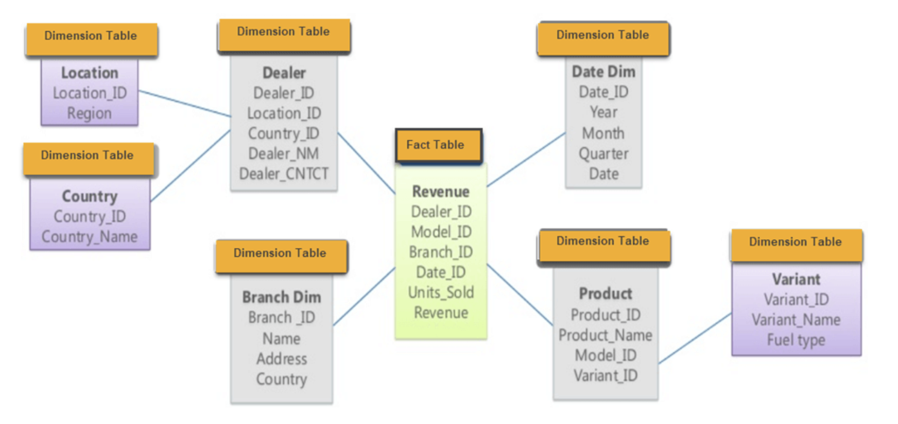
Snowflake Schema

Slide 8
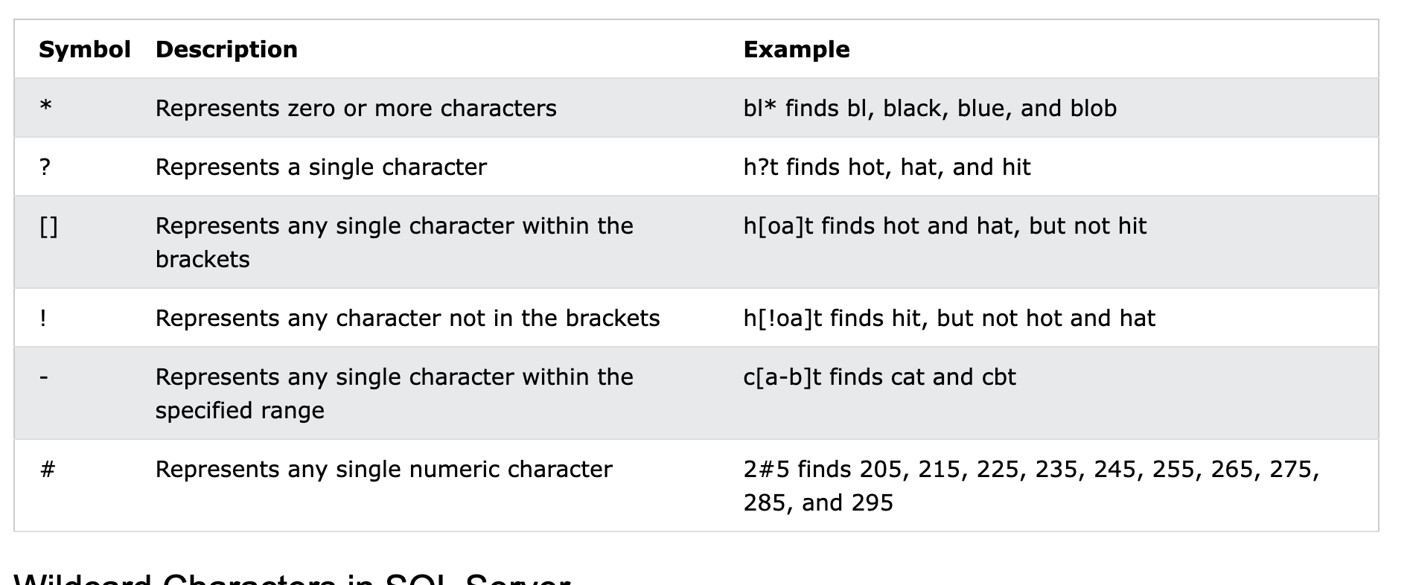
Topics to Cover in Lecture 2
Text vs Numbers
Comments in SQL: #, --, /*
Not equal to sign
Between command
'[acs]%’ '[!acs]%’
'[a-f]%

Slide 9
Topics to Cover in Lecture 3
Importing Date columns as text
Color coding of SQL: Gray = Operator, Pink = Function
YEAR, MONTH
Temporary Table: INTO #hktemp, INTO ##hktemp
Copying the data to Excel

Slide 10
Topics to Cover in Lecture 4
Refresher of Group By Function
Distinct feature in Excel – Not Done
Flow of Processing SQL commands
‘Having’ does not depend on Select statement
Distinct feature in Excel
Count Distinct *

Slide 11
Topics to Cover in Lecture 5
ORDER BY 2 or more columns
ORDER BY on String

Slide 12

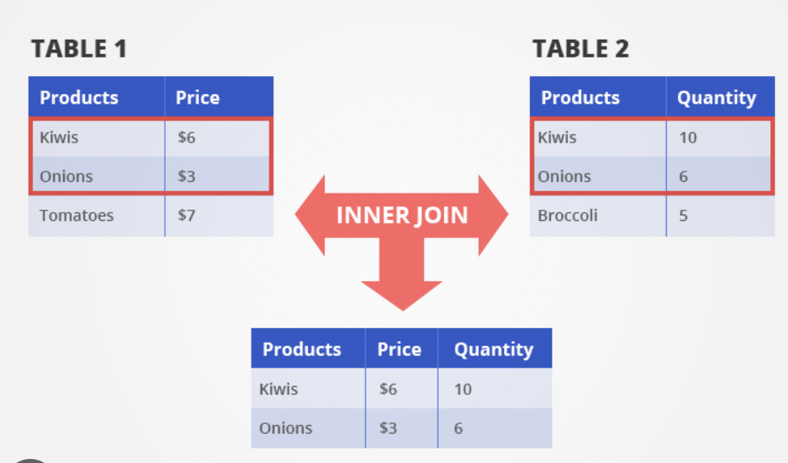
Inner Join

Slide 13
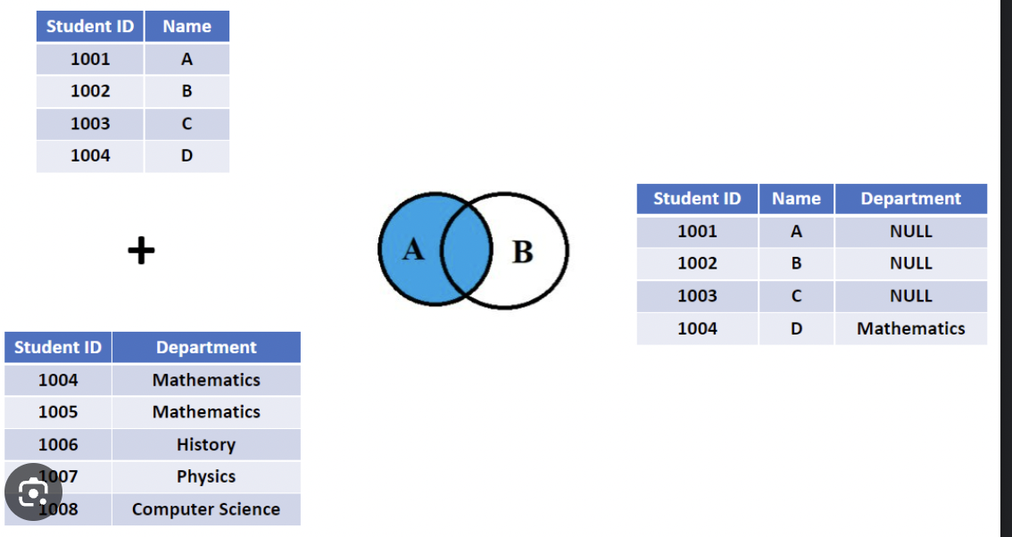
Left Join

Slide 14
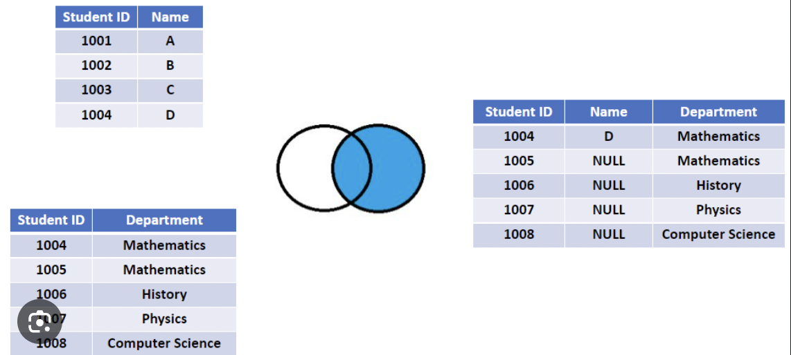
Right Join

Slide 15

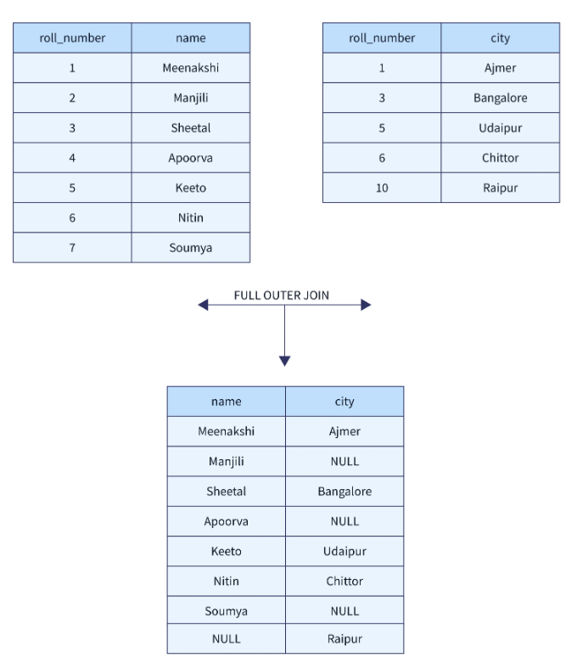
Full Outer Join

Slide 16


Slide 17
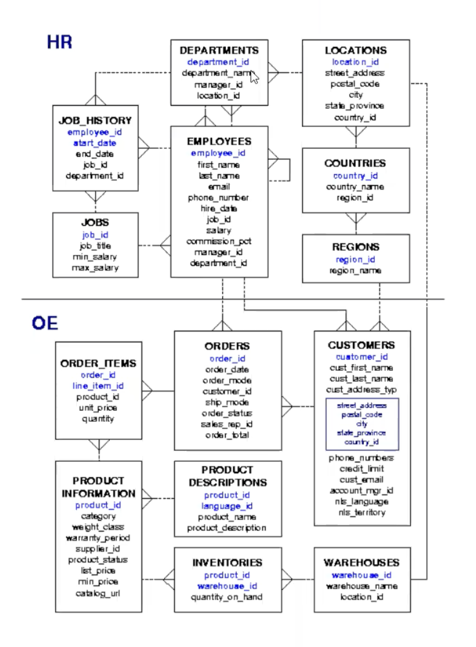

Slide 18
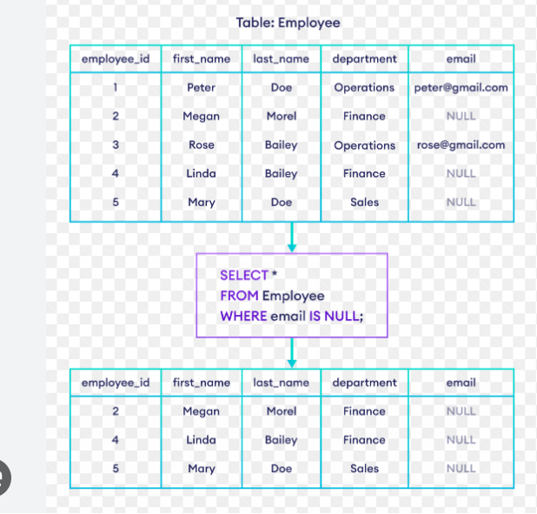
Null/Not Null

Slide 19

Null/Not Null
Select * from customer where city is NULL;
Is not same as
Select * from customer where city = ‘NULL’;
lets say id <> 2, then it won’t pull up the records with id = null. You have to specifically build that into condition that id <> 2 and id is null.

Slide 20
SQL Functions
MODULUS or %: Checking the Remainder:
select distinct city from station where ID%2 = 0;
For Even: Either do MOD(ID, 2) = 0 or ID%2 = 0.
For Odd: Either do MOD(ID, 2) = 0 or ID%2 = 1.
POWER(X, 2): To raise x to the power (exponent) of 2.

Slide 21
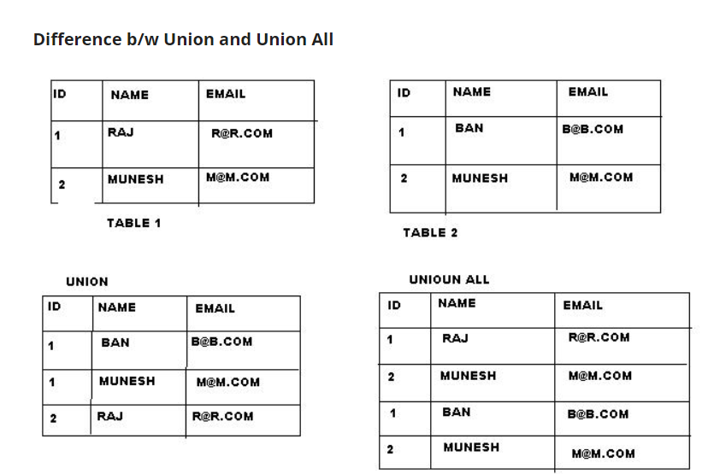
SQL Functions

Slide 22
SQL Functions
TRIM([characters FROM ]string): removes leading spaces or the characters you specify. LTRIM, RTRIM.
Window Functions:
Over() to open a window: If no column is passed to over(), it is going create one window for all the records, will iterate over all rows.

Slide 23
SQL Functions
ROW_NUMBER() to apply row numbers in a table. Specification in the Over() clause will tell us how to apply the row number.
Example:
Select a.CITY, a.CITY_LENGTH FROM
(SELECT CITY, LENGTH(CITY) AS CITY_LENGTH,
Row_number() over(order by LENGTH(CITY) asc, city asc) as short_length_rn,
Row_number() over(order by LENGTH(CITY) desc, city asc) as long_length_rn
FROM STATION) as a
where a.short_length_rn = 1 or a.long_length_rn = 1
order by 1 asc;

Slide 24
SQL Functions
DateAdd
Datediff
Left
Right
GetDate

